Slide 1

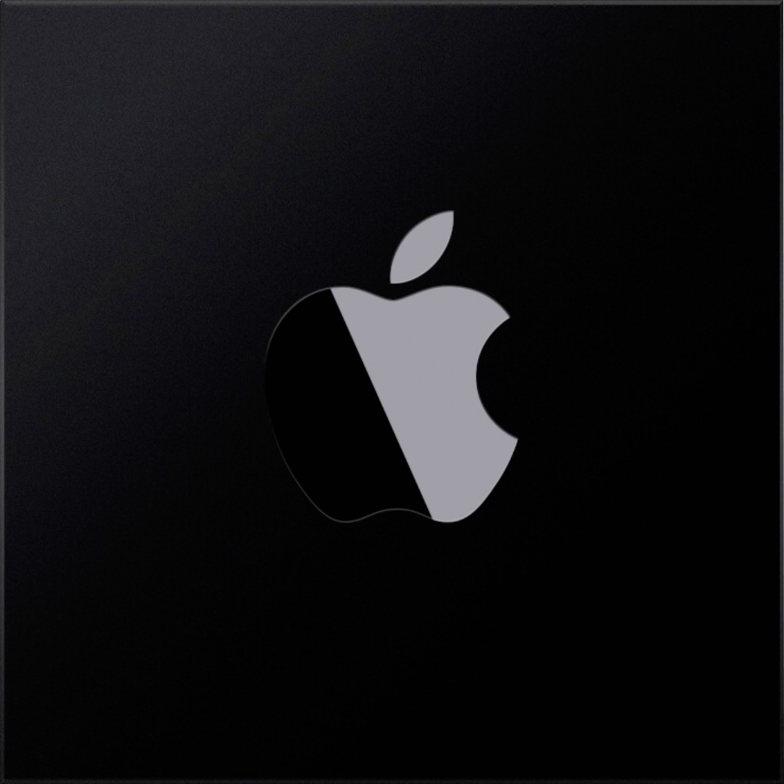
Where can I grab the new wallpapers?
Big Sur is watching you
Apple’s doing processors now, too
I for innovation
Apple Silicon
Amazing
Android had that ages ago
That hand-washing tracker looks handy
Well, they’ve done it, haven’t they?
The dialler’s not full- screen
Looks amazing
The new macOS is proper sexy
Game changing
Amazing
Reminds me of Black Mirror
Pptxman.com
Widgets have finally arrived
It’s neumorphism, for heaven’s sake!
Honestly, it looks rather nifty
Хакинтошники напряглись
Hackintosh fans are proper on edge
Truly awesome

Slide 2
Where can I grab the new wallpapers?
Big Sur is watching you
Apple’s doing processors now, too
I for innovation
Apple Silicon
Amazing
Android had that ages ago
That hand-washing tracker looks handy
Well, they’ve done it, haven’t they?
The dialler’s not full- screen
Looks amazing
The new macOS is proper sexy
Game changing
Amazing
Reminds me of Black Mirror
pptxman.com
Widgets have finally arrived
It’s neumorphism, for heaven’s sake!
Honestly, it looks rather nifty
Hackintosh fans are proper on edge
Truly awesome

Slide 3
Where can I grab the new wallpapers?
Big Sur is watching you
Amazing
Apple’s doing processors now, too
I for innovation
Apple Silicon
That hand-washing tracker looks handy
Android had that ages ago
The dialler’s not full- screen
Well, they’ve done it, haven’t they?
The new macOS is proper sexy
Looks amazing
Game changing
Widgets have finally arrived
Amazing
Reminds me of Black Mirror
pptxman.com
It’s neumorphism, for heaven’s sake!
Honestly, it looks rather nifty
Hackintosh fans are proper on edge
Truly awesome

Slide 4
Where can I grab the new wallpapers?
Big Sur is watching you
Amazing
Apple’s doing processors now, too
I for innovation
Apple Silicon
That hand-washing tracker looks handy
The dialler’s not full- screen
Android had that ages ago
Well, they’ve done it, haven’t they?
The new macOS is proper sexy
Looks amazing
Game changing
Widgets have finally arrived
Amazing
Reminds me of Black Mirror
pptxman.com
It’s neumorphism, for heaven’s sake!
Honestly, it looks rather nifty
Hackintosh fans are proper on edge
Truly awesome

Slide 5
Where can I grab the new wallpapers?
Big Sur is watching you
Apple’s doing processors now, too
I for innovation
Apple Silicon
Amazing
Android had that ages ago
That hand-washing tracker looks handy
Well, they’ve done it, haven’t they?
The dialler’s not full- screen
The new macOS is proper sexy
Looks amazing
Game changing
Amazing
Widgets have finally arrived
Reminds me of Black Mirror
pptxman.com
It’s neumorphism, for heaven’s sake!
Honestly, it looks rather nifty
Hackintosh fans are proper on edge
Truly awesome

Slide 6
Where can I grab the new wallpapers?
Big Sur is watching you
Apple’s doing processors now, too
I for innovation
Apple Silicon
Amazing
Android had that ages ago
That hand-washing tracker looks handy
Well, they’ve done it, haven’t they?
Looks amazing
The dialler’s not full- screen
Reminds me of Black Mirror
pptxman.com
The new macOS is proper sexy
Game changing
Amazing
Hackintosh fans are proper on edge
Truly awesome
Widgets have finally arrived
It’s neumorphism, for heaven’s sake!
Honestly, it looks rather nifty

Slide 7
Where can I grab the new wallpapers?
Big Sur is watching you
Apple’s doing processors now, too
I for innovation
Apple Silicon
Amazing
Android had that ages ago
That hand-washing tracker looks handy
Well, they’ve done it, haven’t they?
Looks amazing
The dialler’s not full- screen
Reminds me of Black Mirror
pptxman.com
The new macOS is proper sexy
Game changing
Amazing
Hackintosh fans are proper on edge
Truly awesome
Widgets have finally arrived
It’s neumorphism, for heaven’s sake!
Honestly, it looks rather nifty

Slide 8
Where can I grab the new wallpapers?
Big Sur is watching you
Apple’s doing processors now, too
I for innovation
Apple Silicon
Amazing
Android had that ages ago
That hand-washing tracker looks handy
Well, they’ve done it, haven’t they?
Looks amazing
The dialler’s not full- screen
Reminds me of Black Mirror
pptxman.com
The new macOS is proper sexy
Game changing
Amazing
Hackintosh fans are proper on edge
Truly awesome
Widgets have finally arrived
It’s neumorphism, for heaven’s sake!
Honestly, it looks rather nifty

Slide 9
I for innovation
Apple Silicon
Where can I grab the new wallpapers?
Big Sur is watching you
Apple’s doing processors now, too
Amazing
В андроиде это уже было давно
Well, they’ve done it, haven’t they?
That hand-washing tracker looks handy
The dialler’s not full- screen
Looks amazing
The new macOS is proper sexy
Game changing
Amazing
Reminds me of Black Mirror
pptxman.com
Widgets have finally arrived
It’s neumorphism, for heaven’s sake!
Honestly, it looks rather nifty
Hackintosh fans are proper on edge
Truly awesome

Slide 10
I for innovation
Apple Silicon
Where can I grab the new wallpapers?
Big Sur is watching you
Apple’s doing processors now, too
Android had that ages ago
Well, they’ve done it, haven’t they?
Amazing
That hand-washing tracker looks handy
Looks amazing
The dialler’s not full- screen
The new macOS is proper sexy
pptxman.com
Game changing
Amazing
Черное зеркало напомнило
Widgets have finally arrived
It’s neumorphism, for heaven’s sake!
Honestly, it looks rather nifty
Hackintosh fans are proper on edge
Truly awesome

Slide 11
I for innovation
Where can I grab the new wallpapers?
Big Sur is watching you
Apple’s doing processors now, too
Android had that ages ago
Apple Silicon
Well, they’ve done it, haven’t they?
Amazing
That hand-washing tracker looks handy
Looks amazing
The dialler’s not full- screen
The new macOS is proper sexy
pptxman.com
Game changing
Amazing
Widgets have finally arrived
It’s neumorphism, for heaven’s sake!
Honestly, it looks rather nifty
Hackintosh fans are proper on edge
Truly awesome

